Slide 1
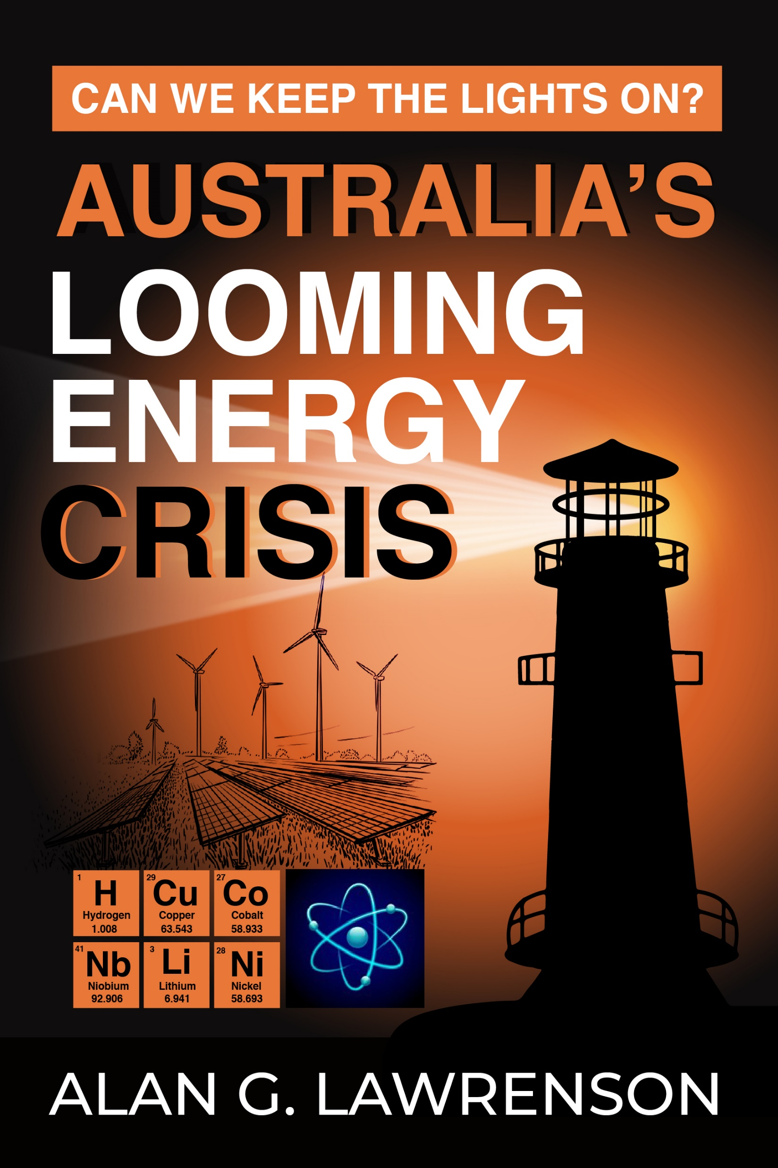

Slide 2

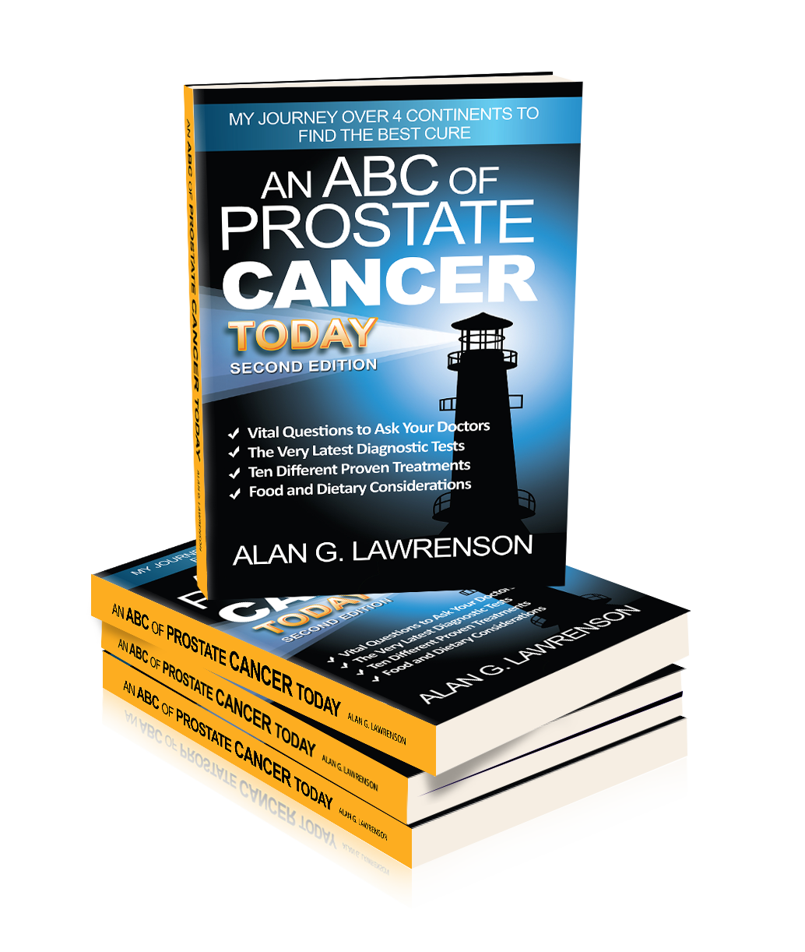
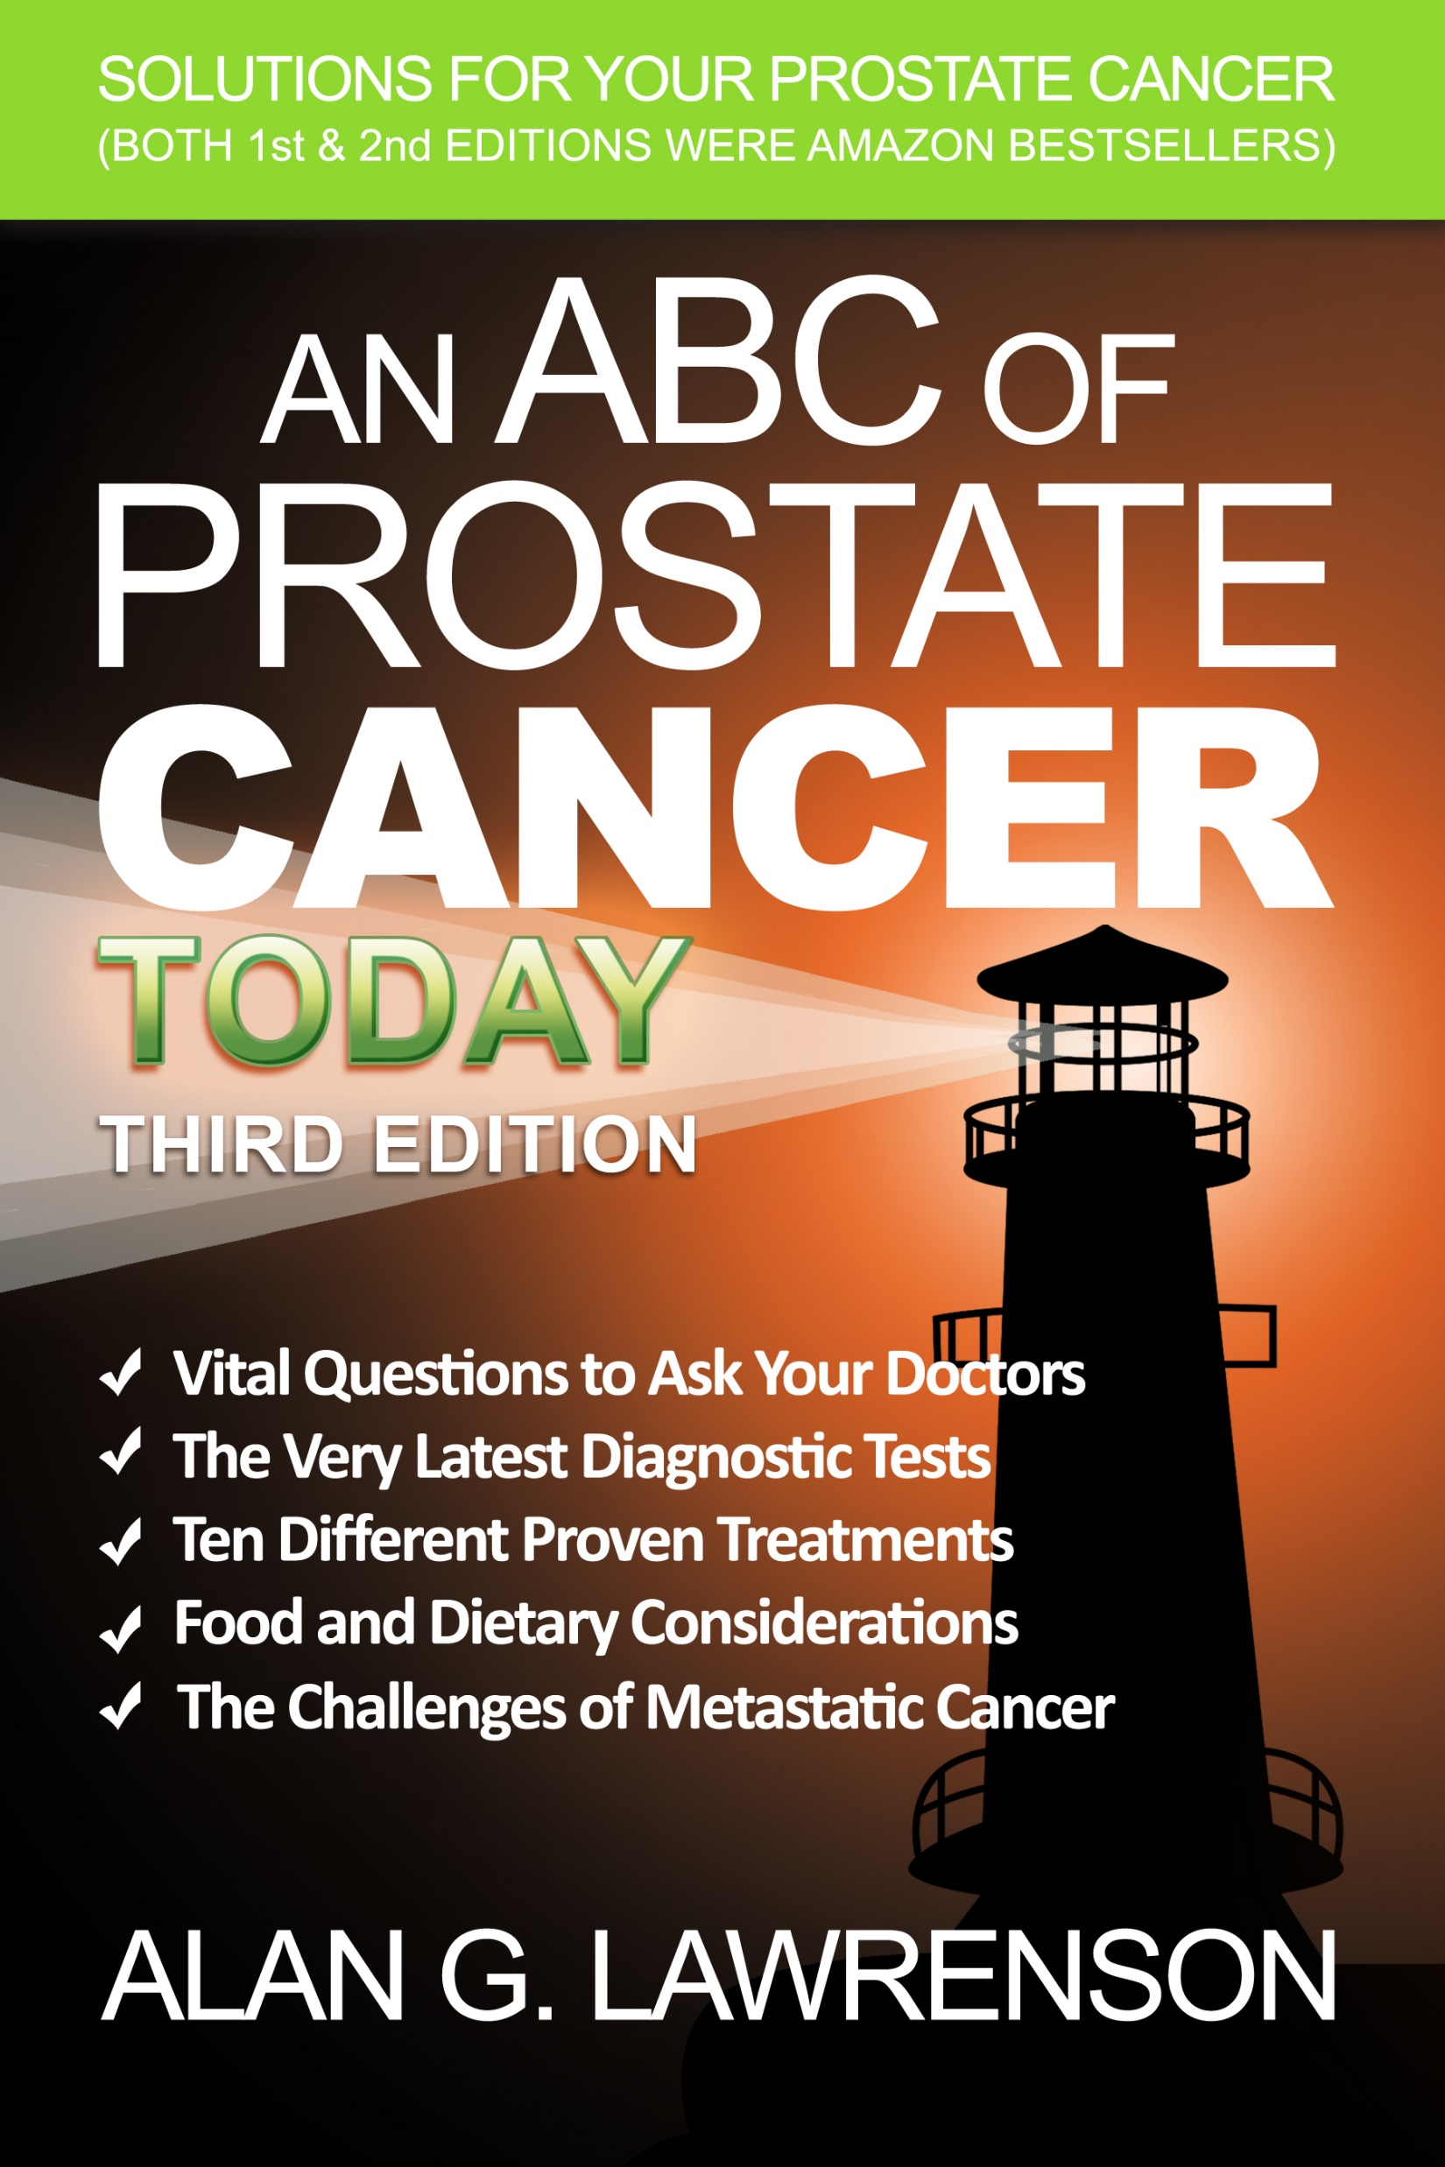
THREE PREVIOUS BESTSELLERS

Slide 3
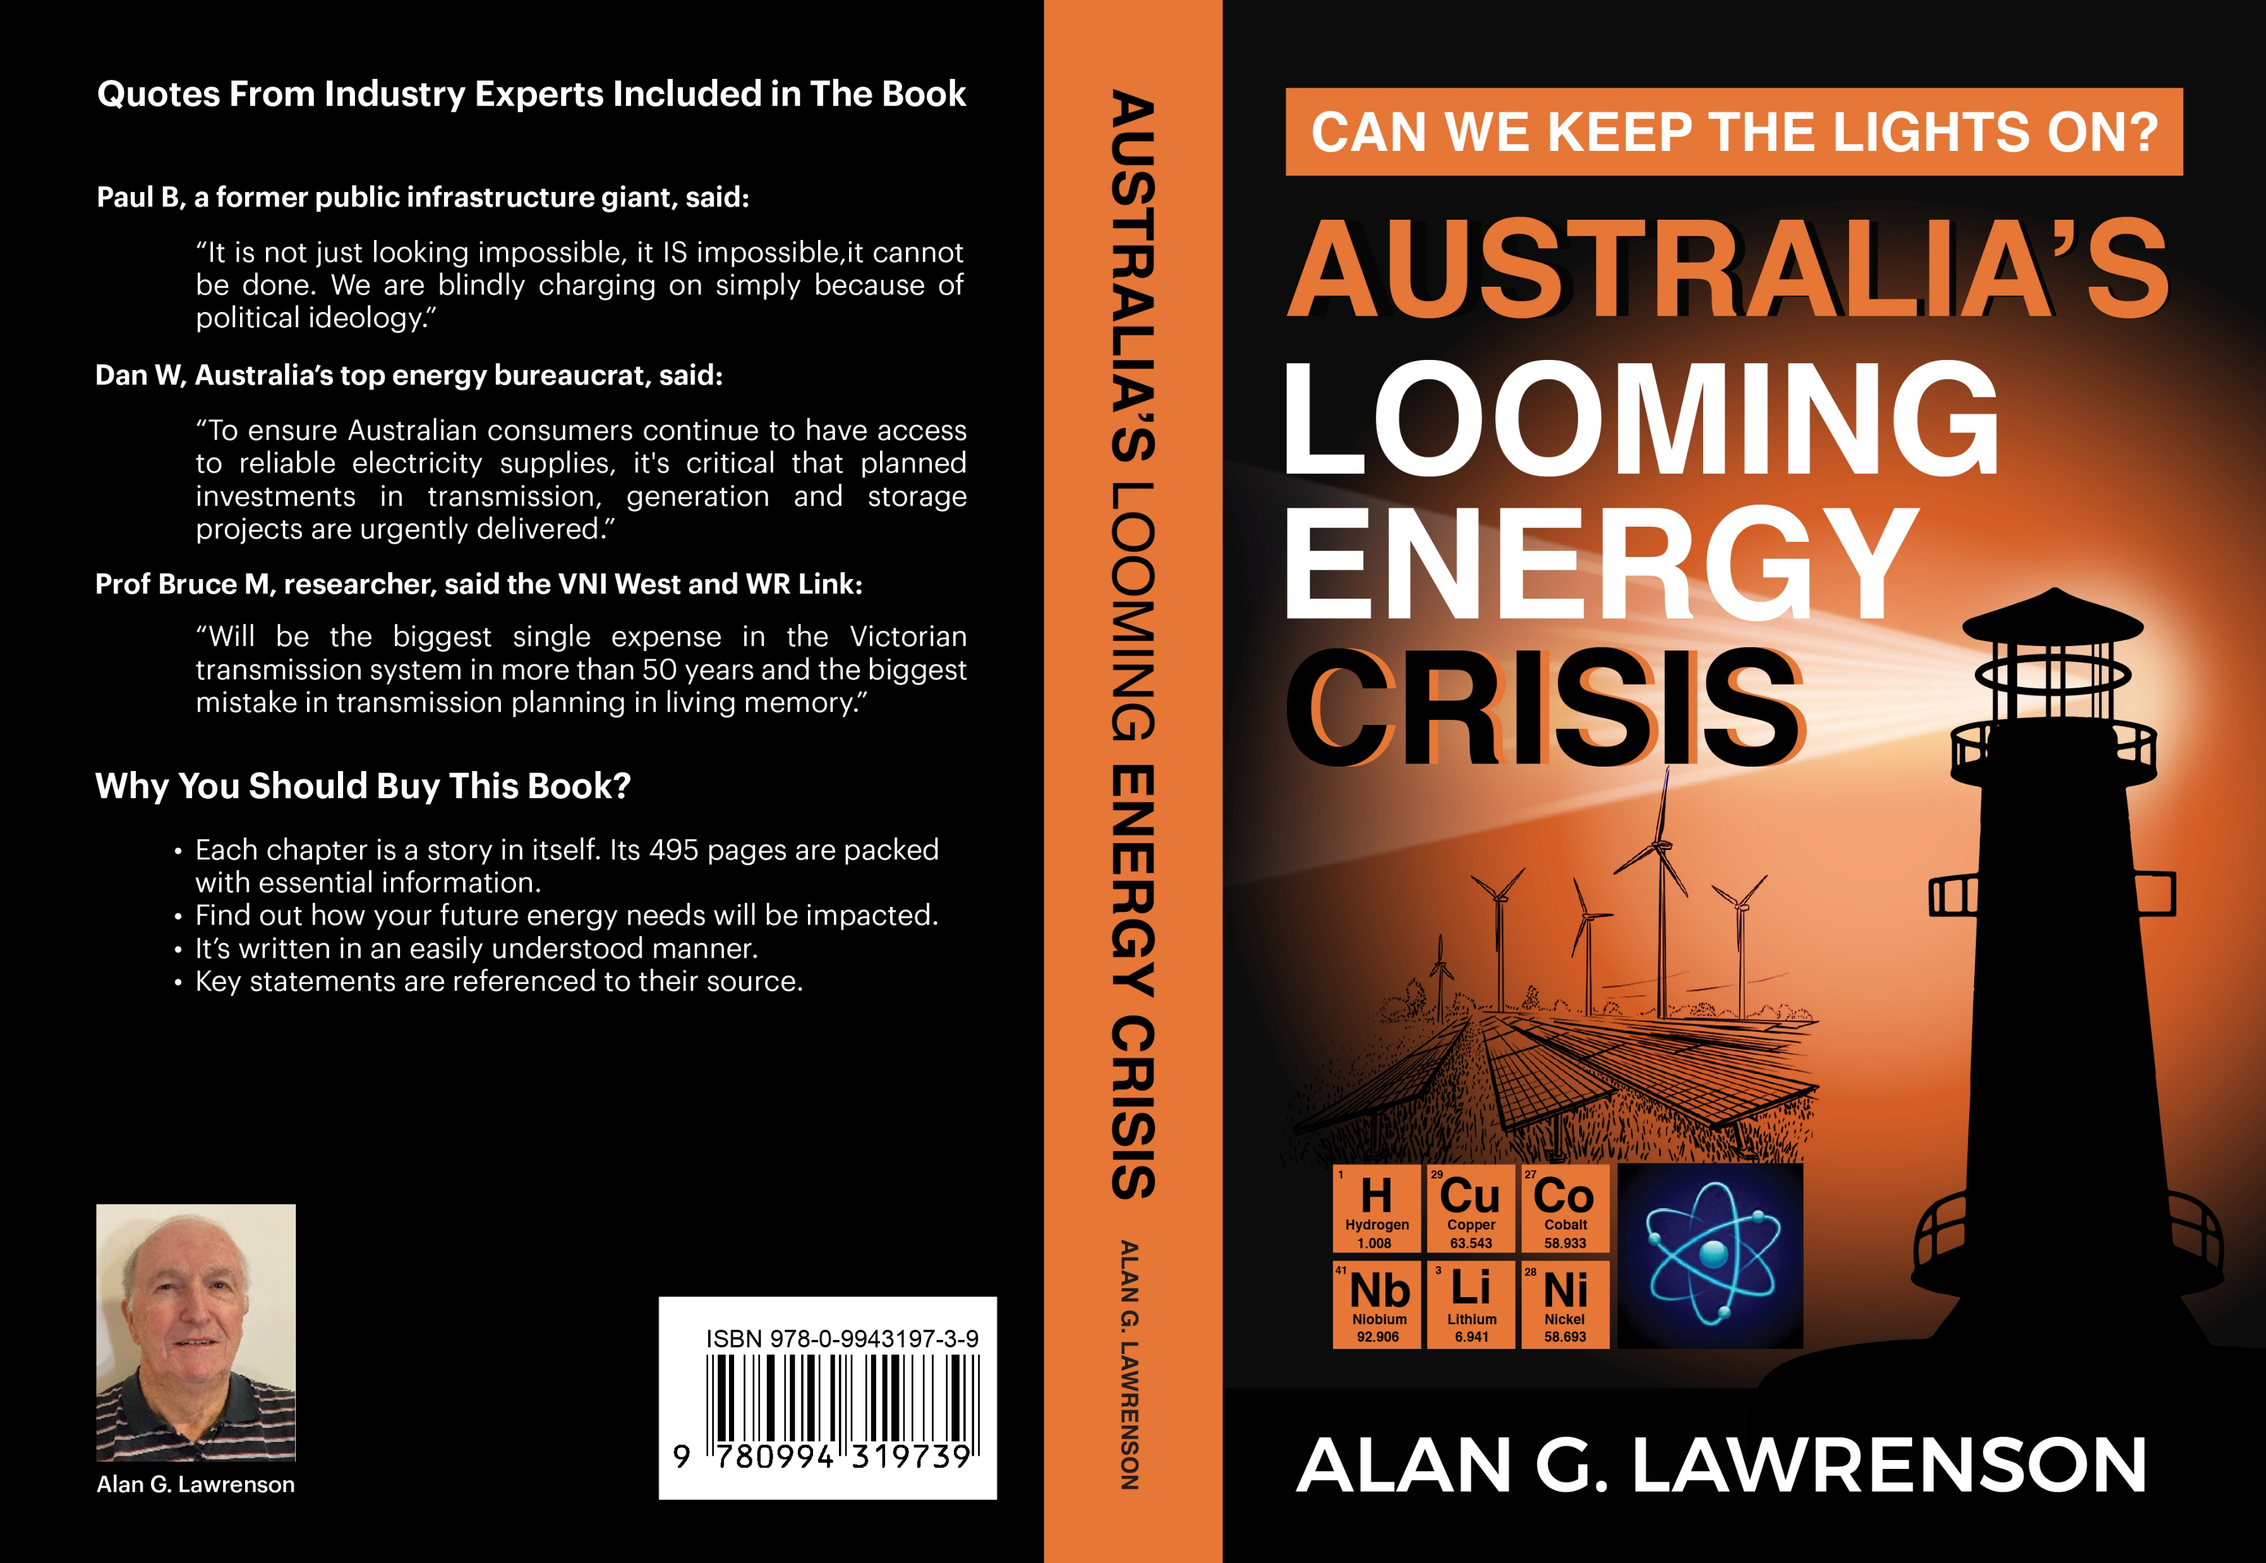

Slide 4
Contents
Chapter 1. | Are we Facing an Energy Crisis in Australia?
Chapter 2. | Climate Change and a Net Zero World
Chapter 3. | Australia's 43% Reduction in GHG by 2030
Chapter 4. | The Present Energy Grid and How it Works
Chapter 5. | The Role of Coal in the Energy Market
Chapter 6. | The Role of Gas in the Energy Market
Chapter 7. | Hydro and Pumped Hydro Generation
Chapter 8. | The Electric Vehicle Market
Chapter 9. | Battery Technology and Recycling
Chapter 10. | Energy Storage, Transmission & Distrib.
Chapter 11. | Solar Now, By 2030 and Beyond
Chapter 12. | Wind Now, By 2030 and Beyond
Chapter 13. | A Hydrogen Economy
Chapter 14. | Biomass and Biofuels
Chapter 15. | Critical Minerals Wanted?
Chapter 16. | A Brief History of Nuclear Energy
Chapter 17. | Nuclear Power Generation Today
Chapter 18. | Nuclear Safety Considerations
Chapter 19. | Large Scale Nuclear Reactors
Chapter 20. | Small Modular Reactors
Chapter 21. | Uranium Mining and Processing
Chapter 22. | Can We Keep the Lights On?
Chapter 23. | Finding a Better Way?
Chapter 24. | Final Thoughts and Actions

Slide 5
Critical Minerals Criticality Analysis in 2030

Slide 6
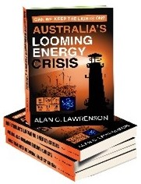
The Book Queries:
$35 (or $40 by Post)
Will Toyota’s Solid - State Batteries Curb the Lithium Demand from 2026 ?
Can we Install 600 Million Solar Panels by 2050?
Who will Win the Poles & Wires Battle?
How to build Nuclear Plants on Time & On Budget

